Slide 1
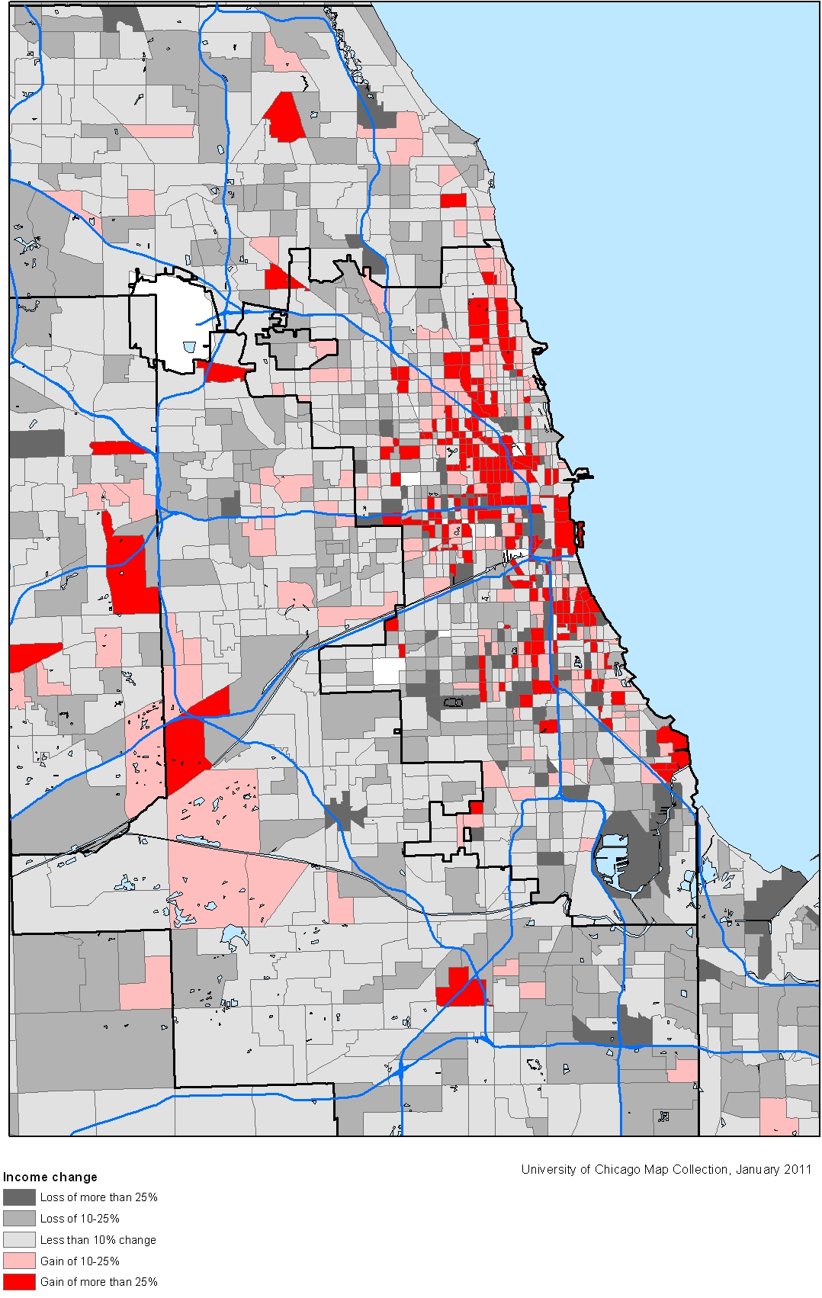
Identifying Gentrification Factors
31 May, 2018
Alisa Babikova, Anupriya Thirumurthy, Arkaparna Mandal, Josep Nueno

Slide 2
Agenda
Executive Summary
Data Planning Pipeline
Ingestion, Preparation, and Cleaning
ETL
Analysis
Reporting - Tableau Server
Challenges
NoSQL
Conclusions and Recommendations

Slide 3
Executive Summary
Neighborhoods in big cities are in a constant state of change due to the movement of people and capital. This trend affects certain demographic groups that are forced to leave due to rising housing prices, increasing cost of living and cultural segregation.
Our goal is to consolidate data to identify factors of gentrification and create indices to detect early signs so that city planners and public officials can take necessary measures and mitigate the effects.
The steps we are going to take include collection of data on demographic indicators, transportation accessibility and use, and housing market, clean the data and build a relational database where we will be able to fit statistical models and produce actionable insights through data visualization tools.

Slide 4















Data Planning Pipeline
Data sources
ETL
Storage and database
Analysis
Reporting

Slide 5



Data Ingestion
Data sources
Google Cloud Platform
Instance
Python
Python
Shape Files
Bucket
Python
Csv files

Slide 6
Data Cleaning & Preparation
Google Cloud Platform
Instance
Raw Data
Dimensional Model
Visualization

Slide 7
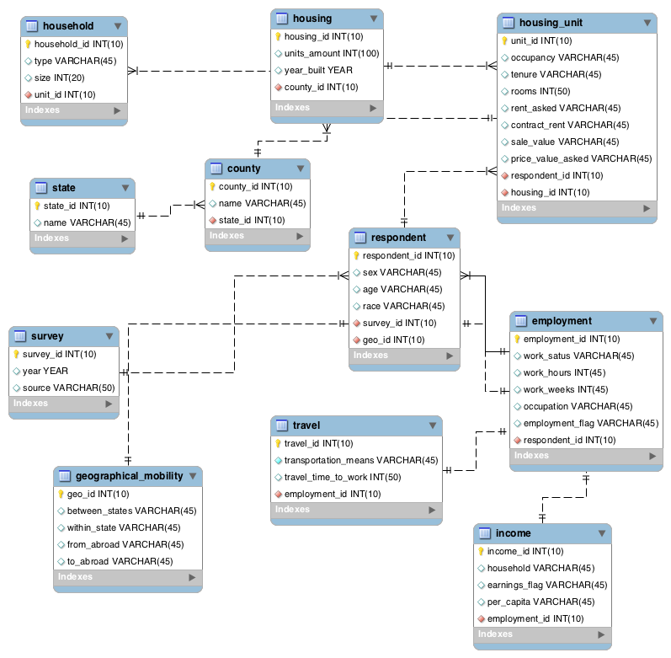
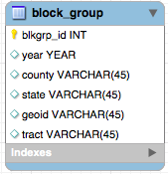
ER Diagram - Census (PostgreSQL)

Slide 8
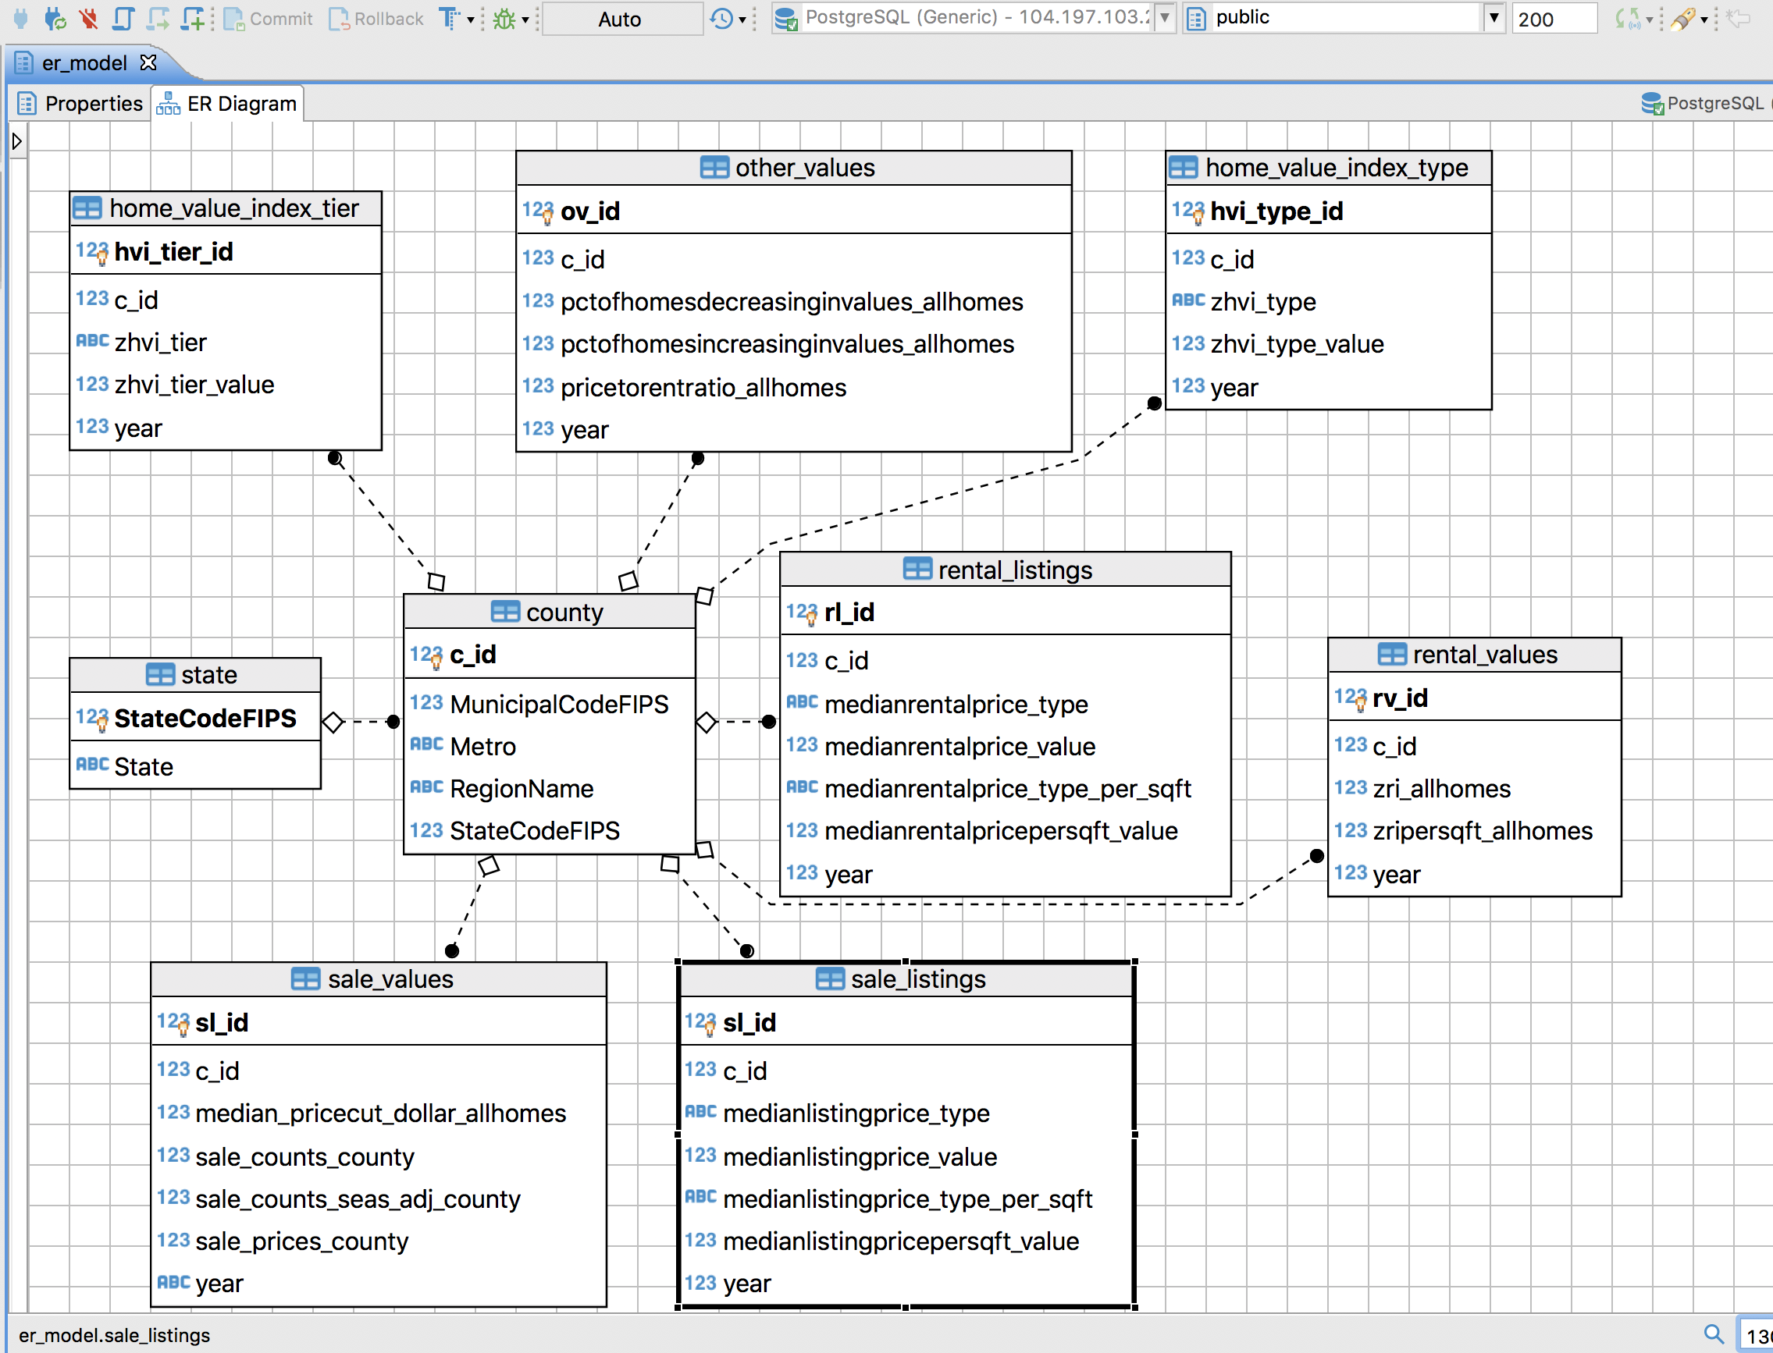
ER Diagram – Zillow (DBeaver)

Slide 9
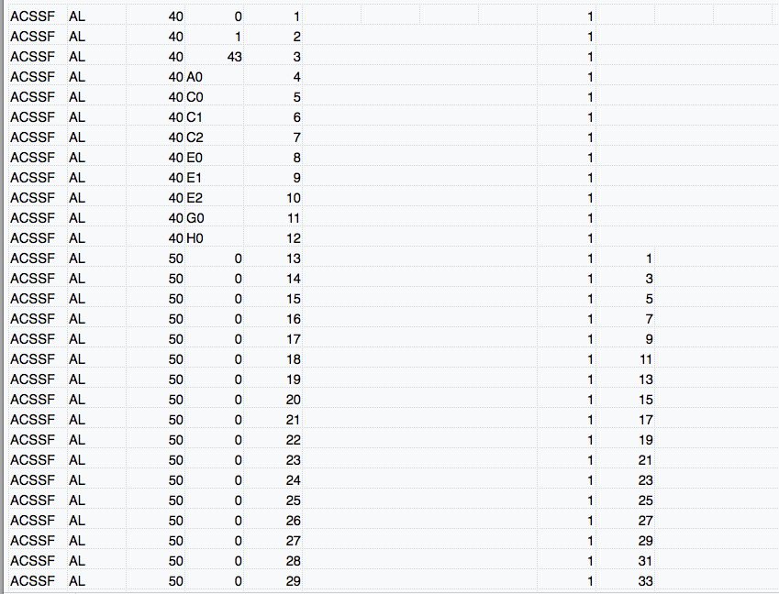
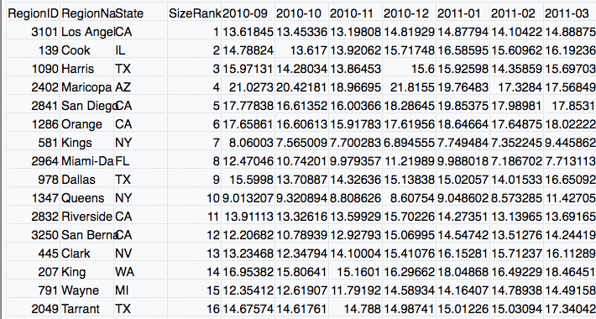
ETL - Extract
Datasets: ACS Survey 2010-2016 (Census), Zillow Home Value 2010-2017 - extracted with Python
Total ~89GB Data
Zillow data broken down by months
Separate dataset for each home type
Only a few columns chosen for analysis (ex: RegionName and not RegionID)
No defined columns in Census data
Massive (50 GB+ per year unzipped)
900+ variables initially narrowed down to ~50
ACS survey (Census) dataset was the hardest to extract useful column names from as none of them were properly named
Used data dictionary to narrow down to 900+ and then to around 50 useful for our analysis column names

Slide 10
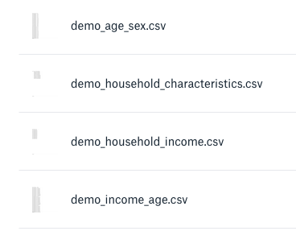
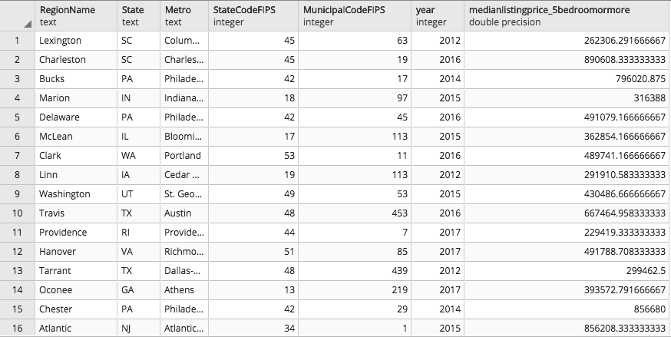
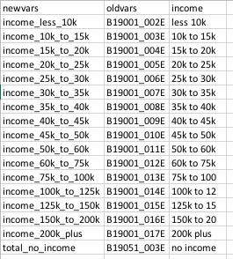
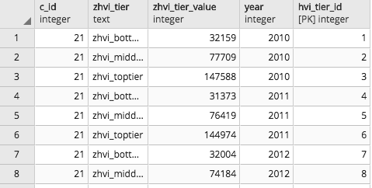
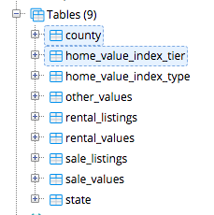
ETL - Transform
Extracted columns were then normalized using python scripts and procedural PostgreSQL
Census data was unnormalized
Extraction and population of pSQL tables achieved with Python
Variables and values defined for analysis
Data split into separate tables
Zillow data first split into normalized tables
Removed all null values
Data then transformed into ER diagram tables

Slide 11
Dimensional model - Census
Demographics
Geography translation tables
Real estate
Rented houses
Owned houses
Zillow indexes
Age
Income
Race
Counties
Metro areas
Zillow areas
-Blkgrp ID
…
-Blkgrp ID
…
-Blkgrp ID
…
-Blkgrp ID
-County ID
-Multiplier
-Blkgrp ID
-Metro ID
-Multiplier
-Blkgrp ID
-Zillow ID
-Multiplier
-Blkgrp ID
- Prices
- Characte.
-Blkgrp ID
- Prices
- Characte.
-Blkgrp ID
…
Mobility
Tenancy
Block group shapefile
Time to work
Transportation
Tenure
Mobility
Amenities
-Blkgrp ID
…
-Blkgrp ID
…
-Blkgrp ID
-geometry
-model variables
-Blkgrp ID
…
-Blkgrp ID
…
-Blkgrp ID
…
Areas of risk model output
Openstreetmap
Historical scores
At-risk areas score
Score projections
Public transport
Amenities
-Blkgrp ID
…
-Blkgrp ID
…
-Blkgrp ID
…
-Blkgrp ID
…
-Blkgrp ID
…

Slide 12
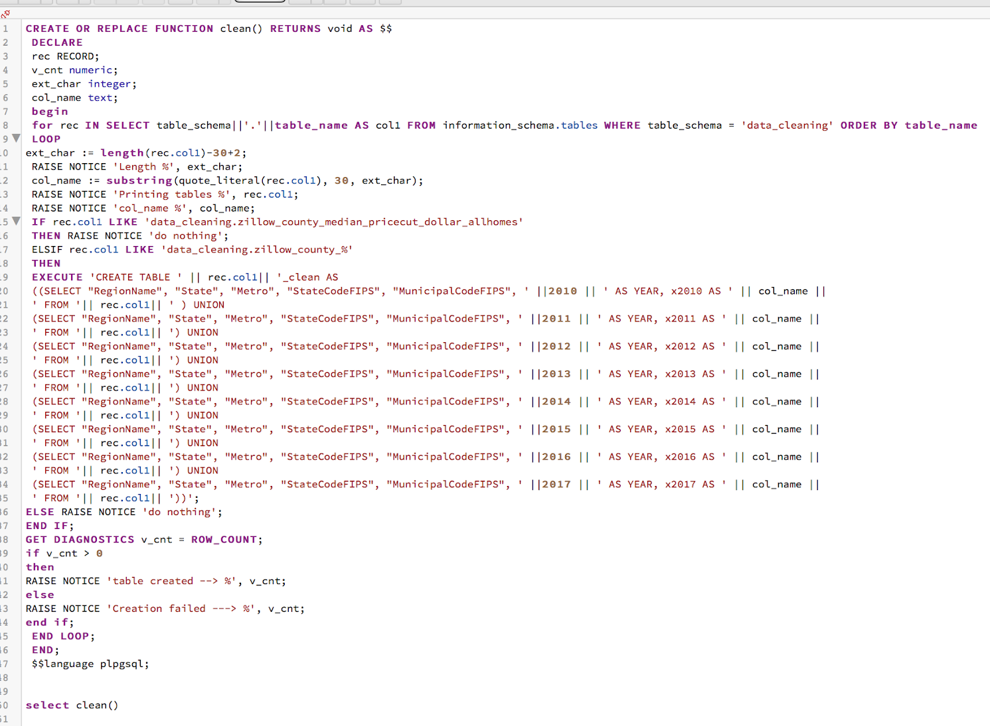
Procedural PostgreSQL

Slide 13
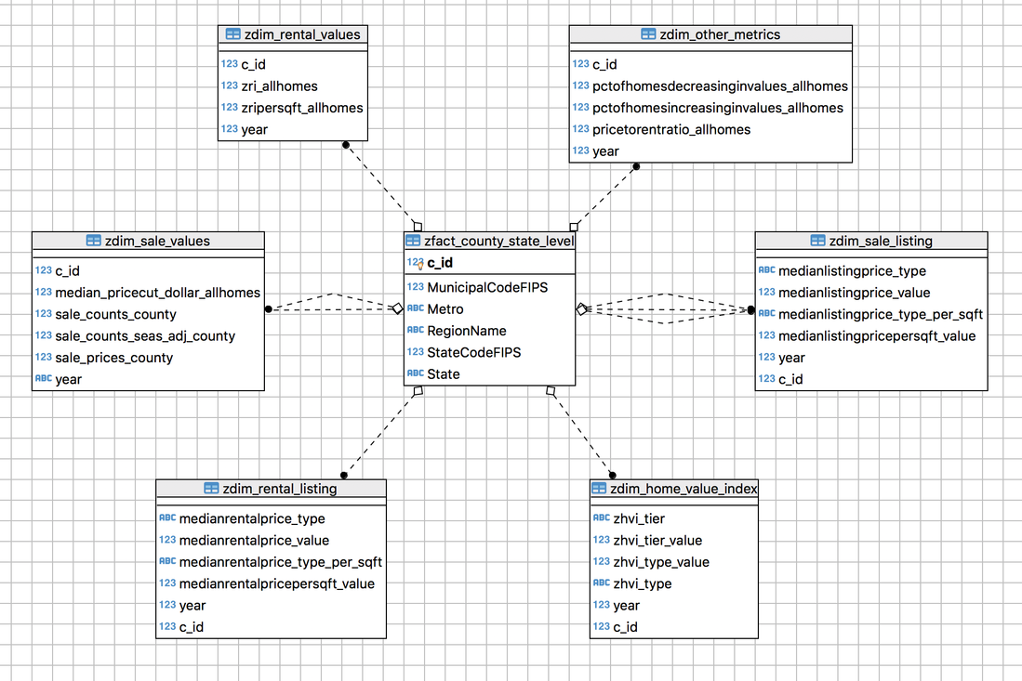
Dimensional model - Zillow (DBeaver)

Slide 14
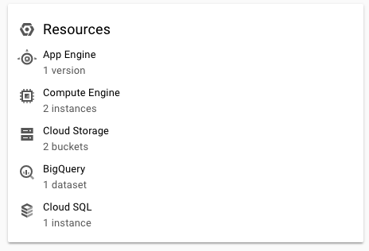
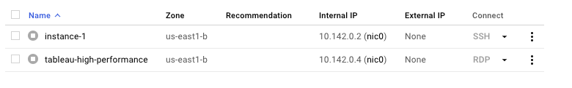
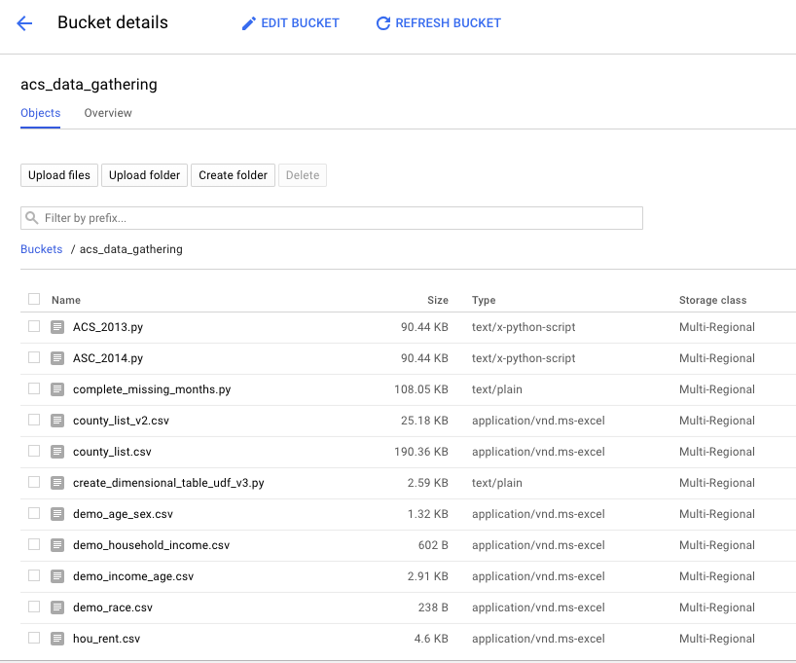
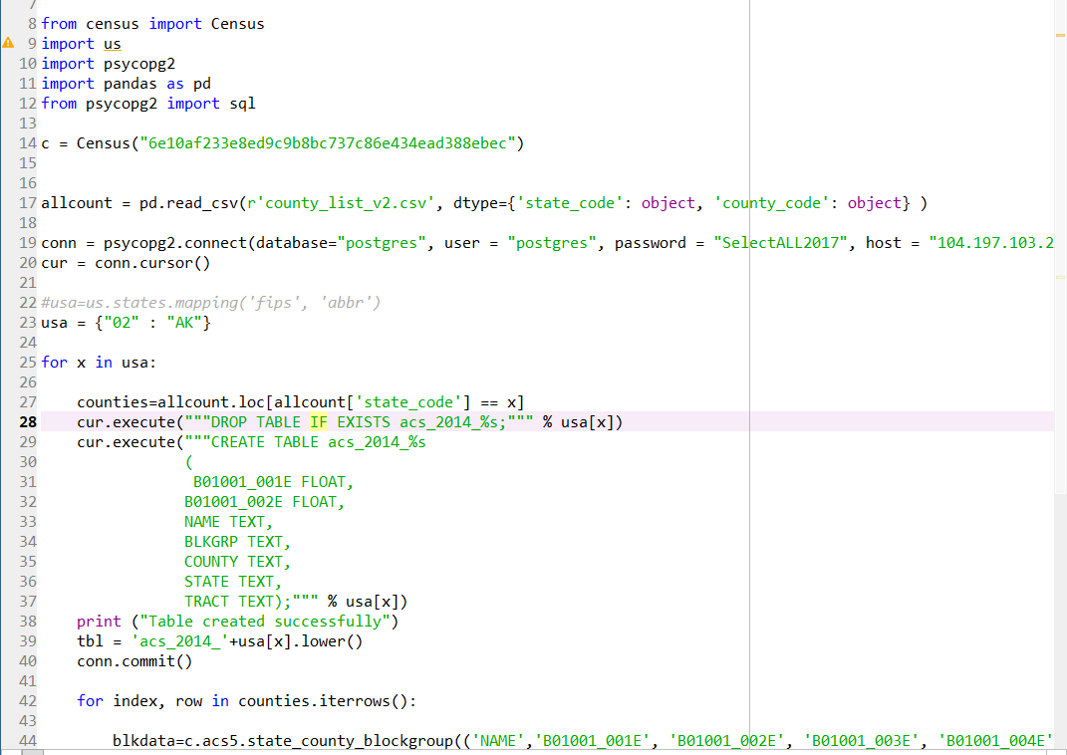
Data Storage
Data was loaded into Google Cloud Platform through instances using Python scripts and stored in storage buckets
Utilized GCP as main platform for our data ingestion, storage, and reporting processes
Called Census API to update data & check integrity through Python scripts

Slide 15
Methodology for Analysis - Gini Index
A Gini index is a measure of statistical dispersion and most commonly used for indicating inequality. A Gini index will have a low value in a poor neighborhood indicating less inequality among Income level, Rent Prices and so on but also a lower standard of living. However as investments pour into such a neighborhood, house income, Rent prices start going up creating inequality hence resulting in a high Gini index. Over the course of years this upward trend eventually reaches a higher state of equilibrium. This in turn is associated Higher standard of living and lower inequality.
Gentrification is ongoing/High Gini index/High Inequality & decoupling of values
Our goal is to rank city Block- Groups/Neighborhoods based on these indices. During the gentrification process we expect inequality (in rents, valuation and income) to spike so we built our metric to detect such changes.
Investment
Saturation
Pre-Gentrification/
Low Gini Index/lower inequality
Post-Gentrification asked and actual values merge, Gini reverts

Slide 16
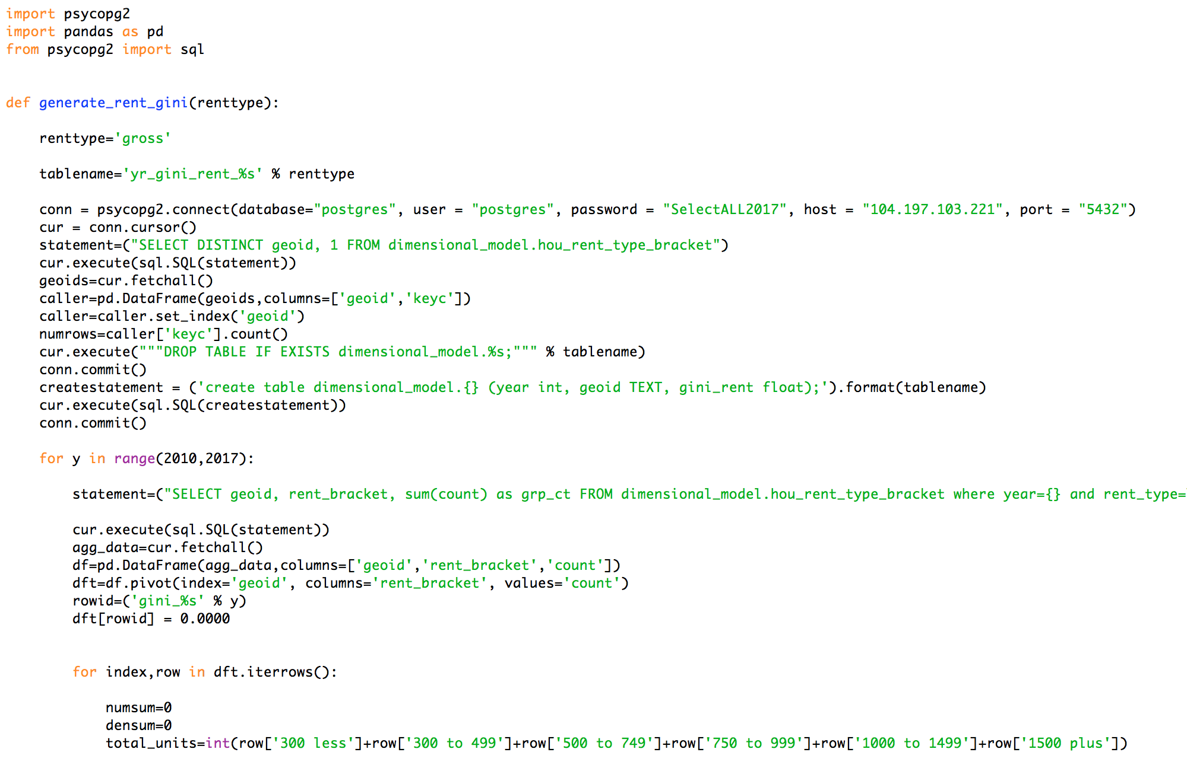
Analysis (Python)
Step 1
Step 2
Step 3
Fit Linear model on the master data:
On Income Change, Rental Price change and other factors
Find significant explanatory vars
Check pairwise correlation
Identify key Gentrification Indicators:
Household Income
Rental Prices
Property Prices
Pull data from Dimension tables using python scripts and create indices based on each indicator
Step 2
Step 4
Indices:
Income Gini index
Rent Gini Index
Property Value Index

Slide 17
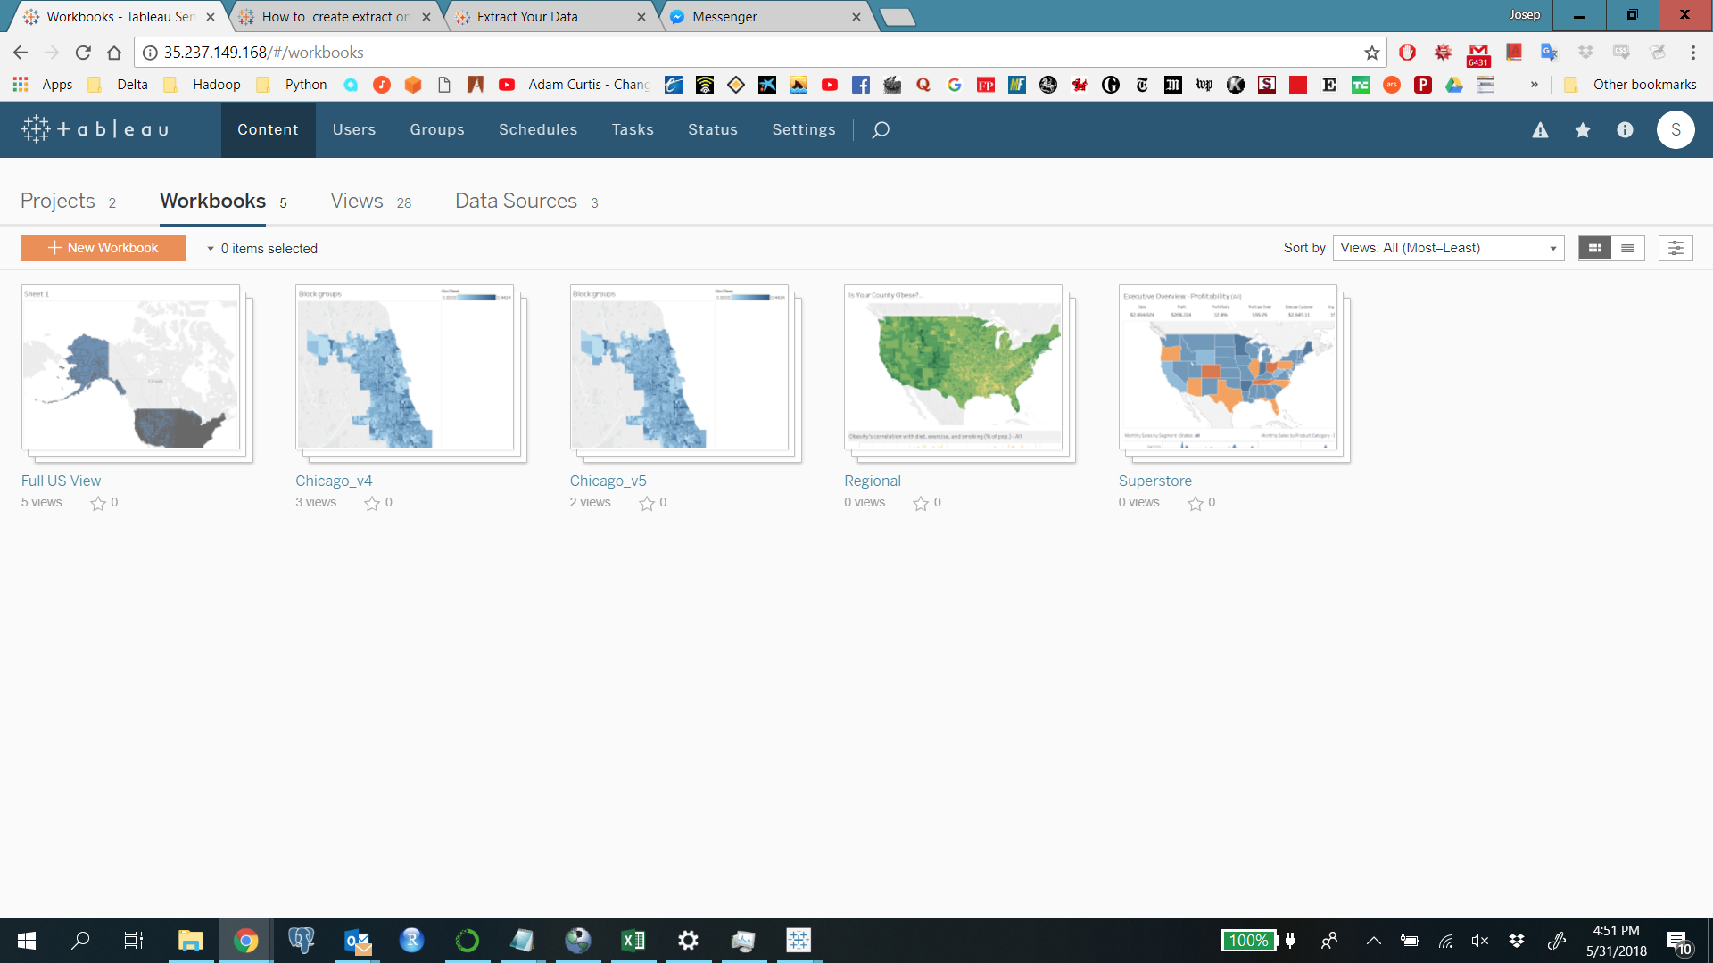
Reporting-Tableau Server on GCP
A tableau server was set up on GCP to facilitate collaboration and dashboard creation

Slide 18
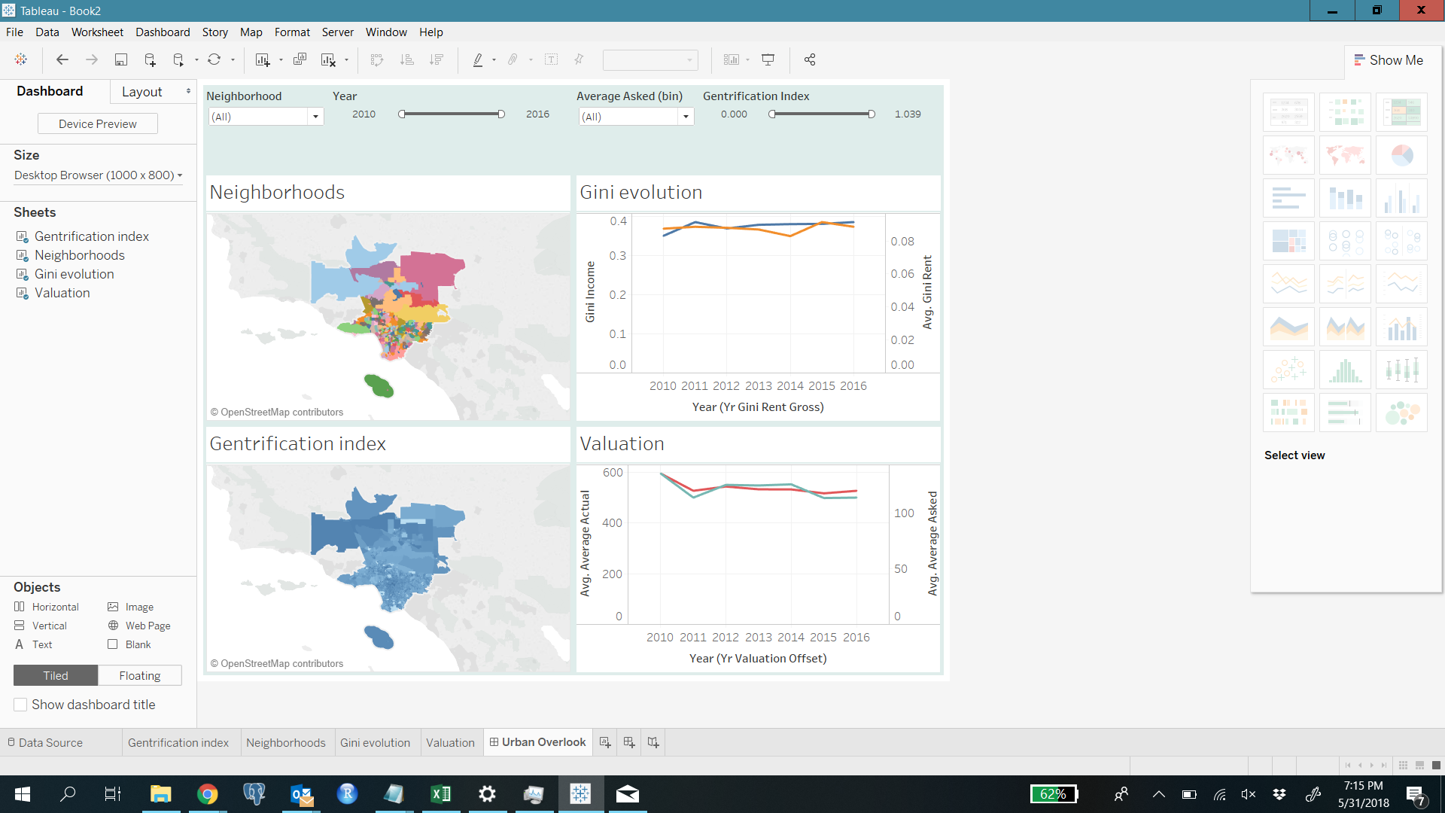
Dashboard – Los Angeles
Neighborhoods in the outskirts have higher ginis (and so gentrification score) since they have larger areas and therefore more diversity (area of improvement)
Overall for the town rent gini is low, spiking for specific
For the city in aggregate asked and actual valuation fluctuate in similar ways

Slide 19
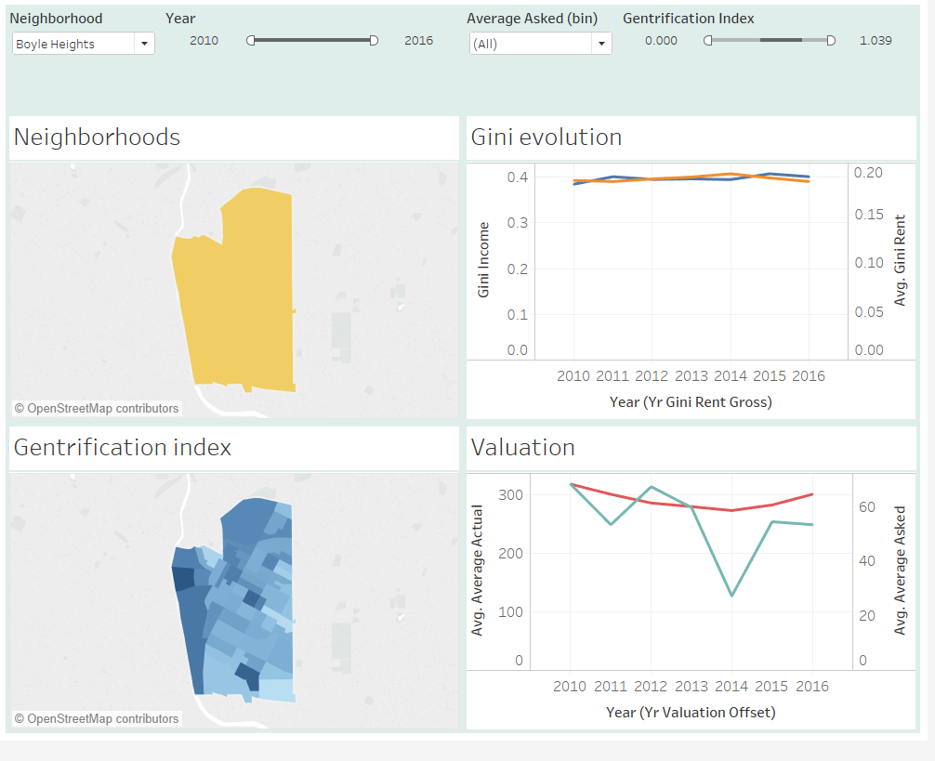
Dashboard – Los Angeles: Boyle Heights
Overall one of the highest scoring neighborhoods in LA when correcting for area
Asked and actual valuations are decoupled, and Gini indexes relatively high
Can appreciate a lot of variation within the neighborhood, highlighting where the gentrification clusters are located

Slide 20
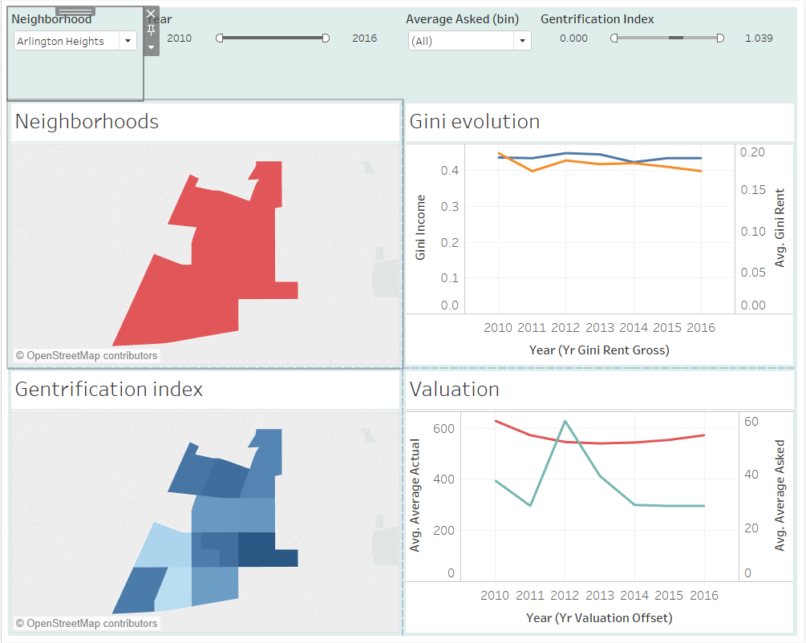
Dashboard – Los Angeles: Arlington Heights
Overall one of the highest scoring neighborhoods in LA when correcting for area
Asked and actual valuations are decoupled
Both Gini indexes are relatively elevated and increasing slightly

Slide 21
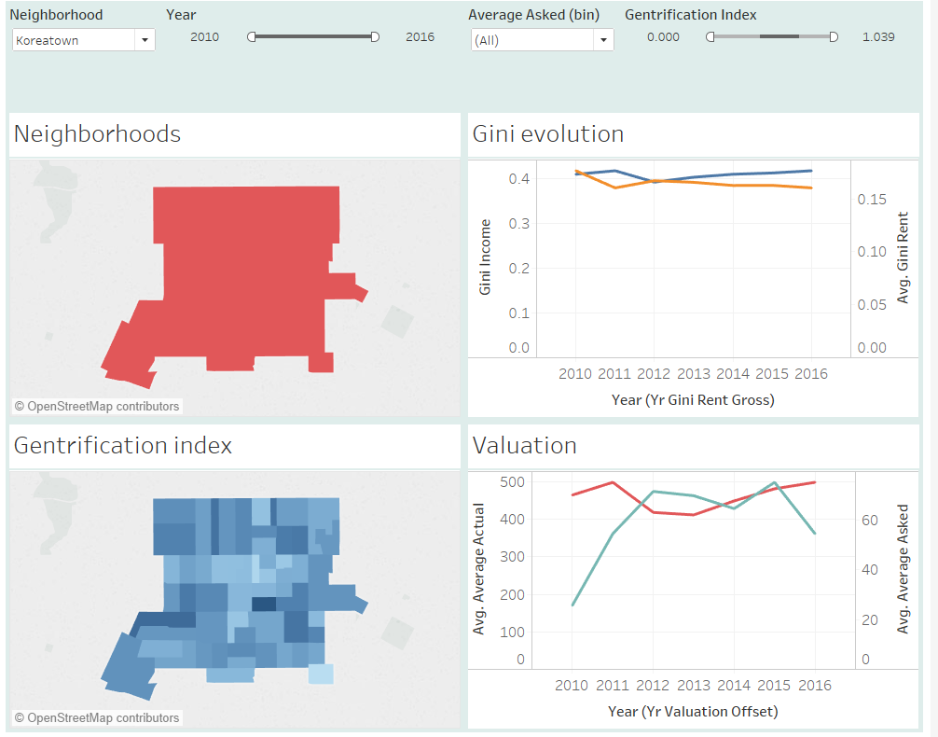
Dashboard – Los Angeles: Koreatown
Overall one of the highest scoring neighborhoods in LA when correcting for area
Asked and actual valuations are decoupled
Both Gini indexes are relatively elevated

Slide 22
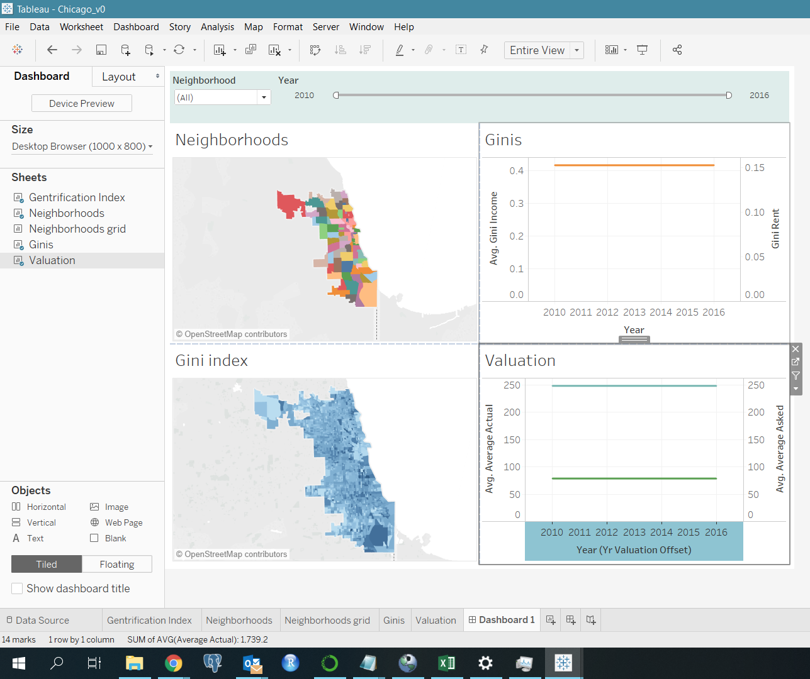
Dashboard - Chicago
Pull BlockGroup/Neighborhood level data in Tableau
Create Dashboards by City
Visualize BlockGroups ranked by Indices created as Gentrification indicators
Visualize Neighborhoods ranked by Indices created as Gentrification indicators

Slide 23
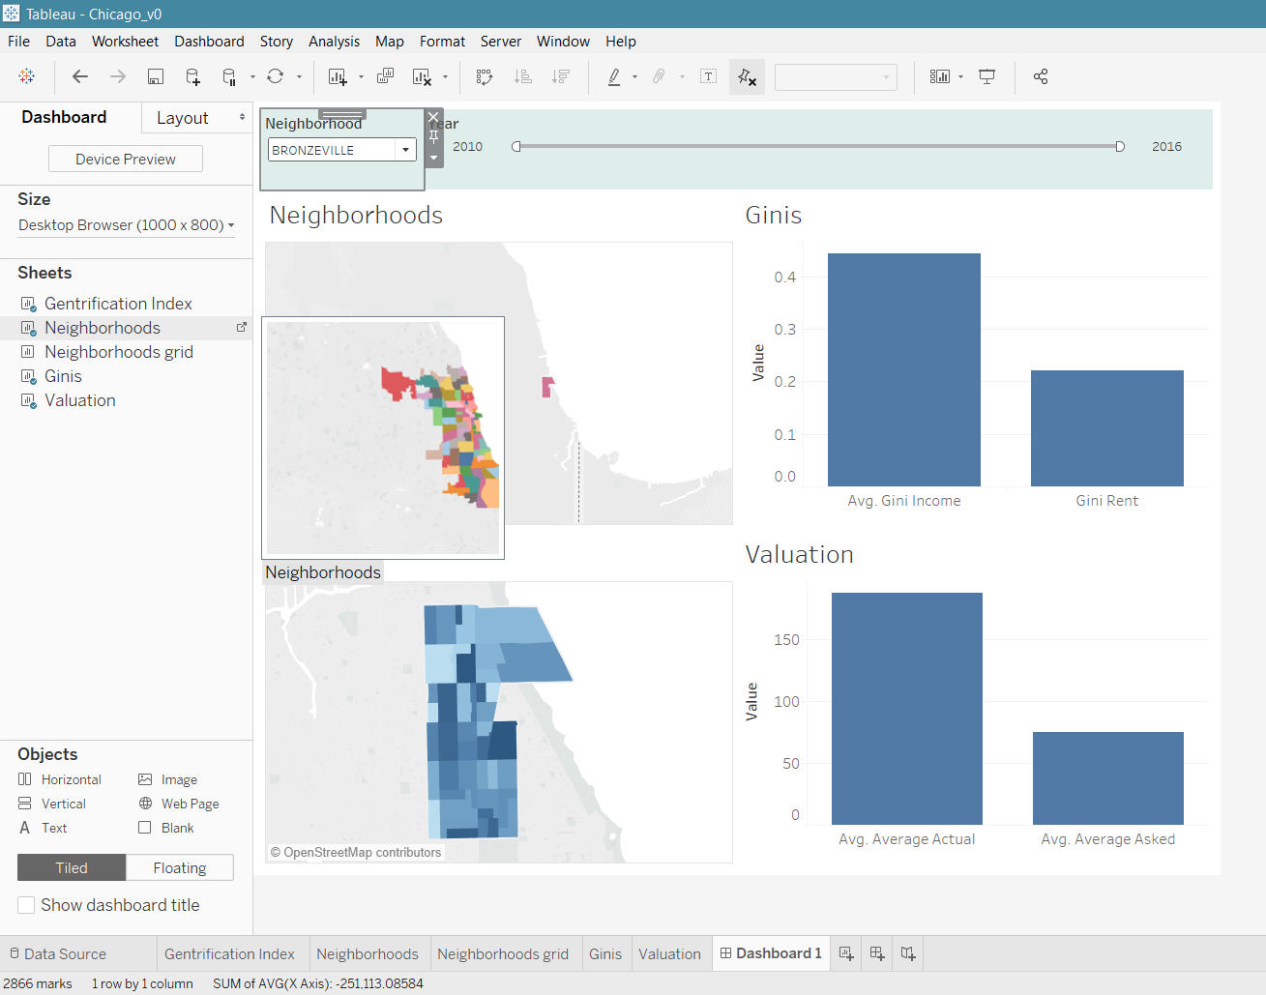
Dashboard – Chicago
Ranking Neighbourhoods by Gini index and Valuation Index
We are looking at Bronzeville Neighborhood
Indices point to the existence of some kind of income inequality. Also there is a gap between actual and asked property valuation prices- pointing to Gentrification

Slide 24
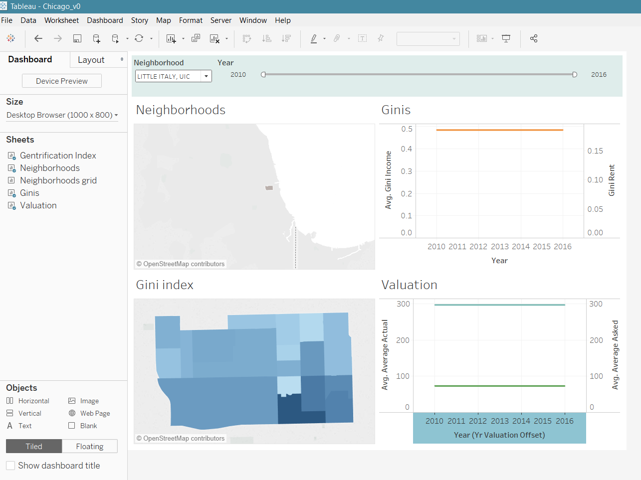
Dashboard – Chicago
Little Italy has a very high Gini Index in terms of Household Income and a significant Gap exists between asked and actual Property valuation prices

Slide 25
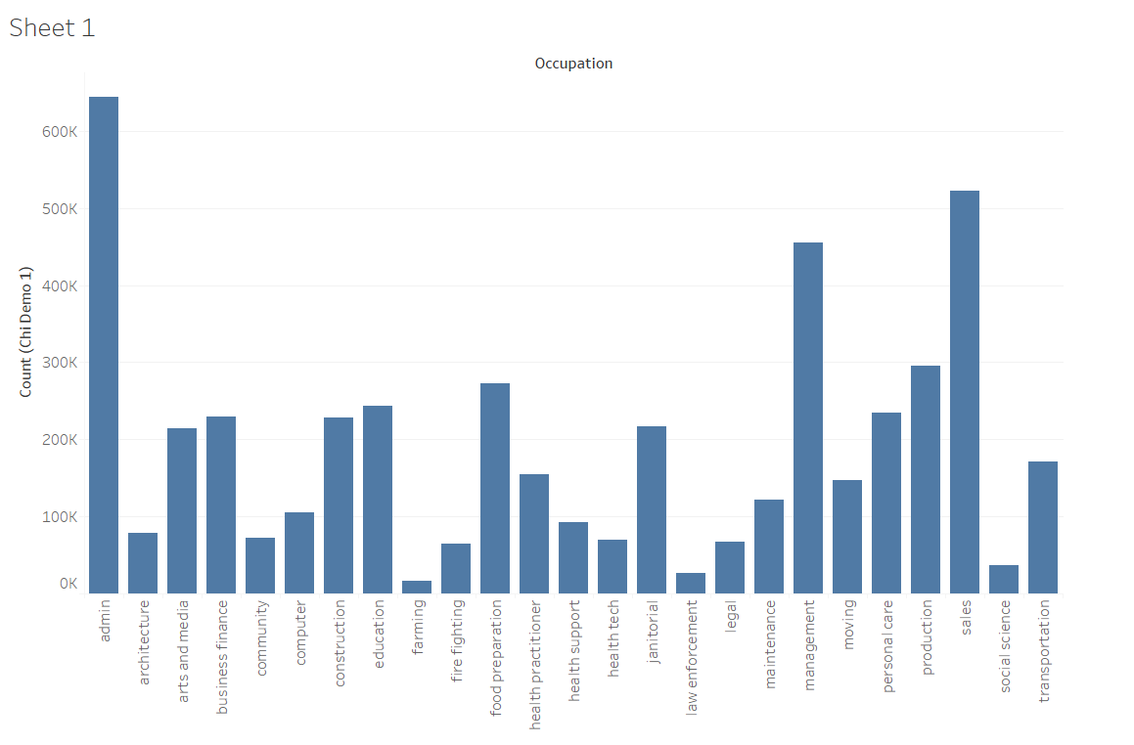
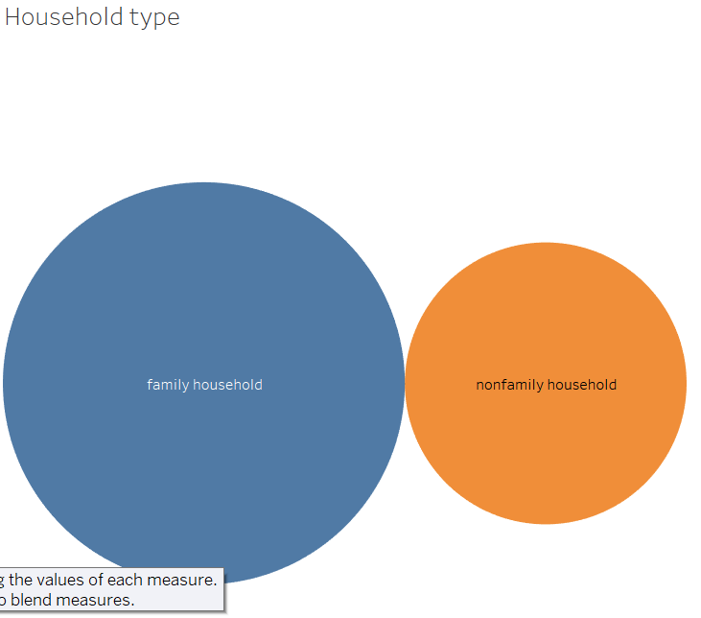
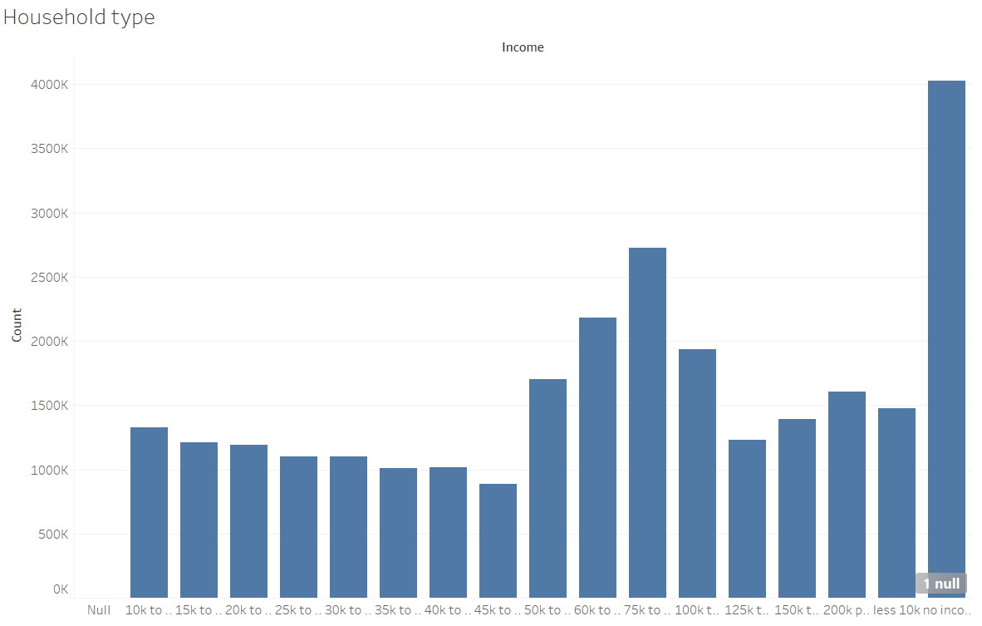
Demographic Visualization
Analysis can be further enriched by adding demographic information to areas with high gentrification indexes

Slide 26
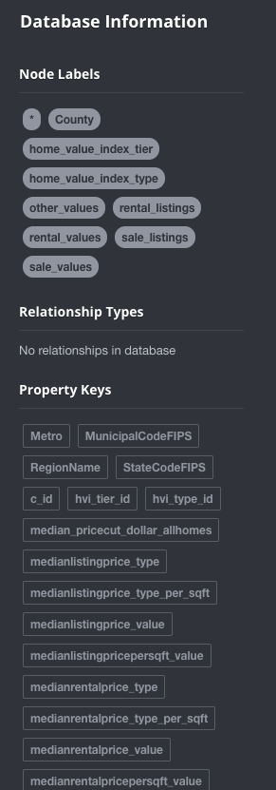
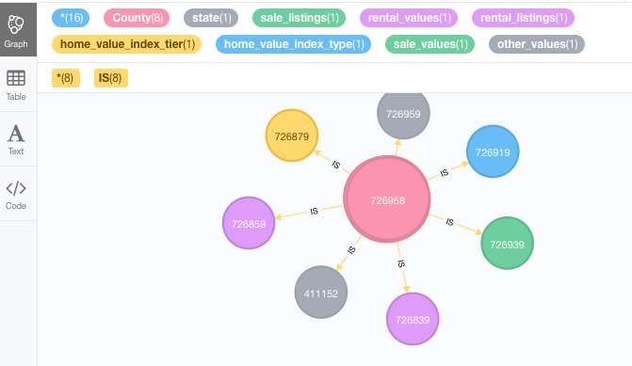
NoSQL - Neo4j Graph of Zillow Data
Imported data from PostgreSQL into Neo4J
Created nodes mimicking the tables in the ER diagram for Zillow data
Indexed keys and created relationships

Slide 27
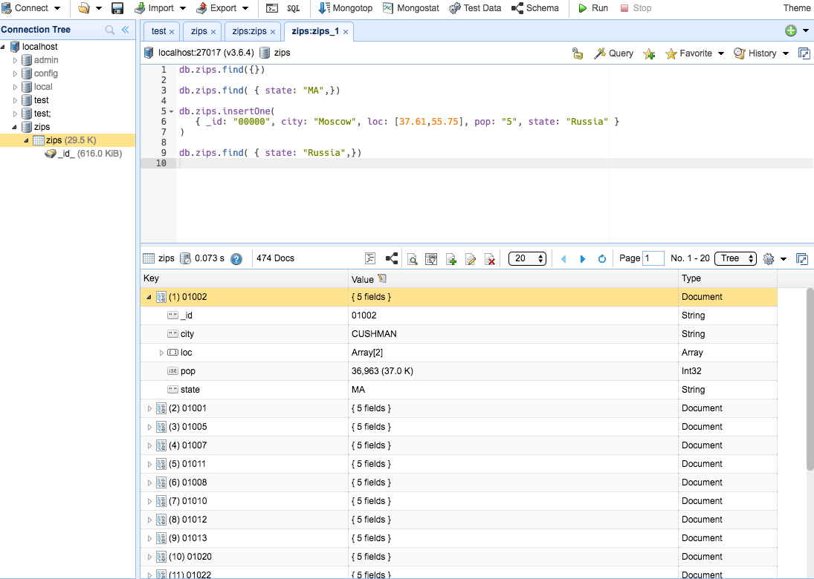
NoSQL - MongoDB Zip-Level Data

Slide 28
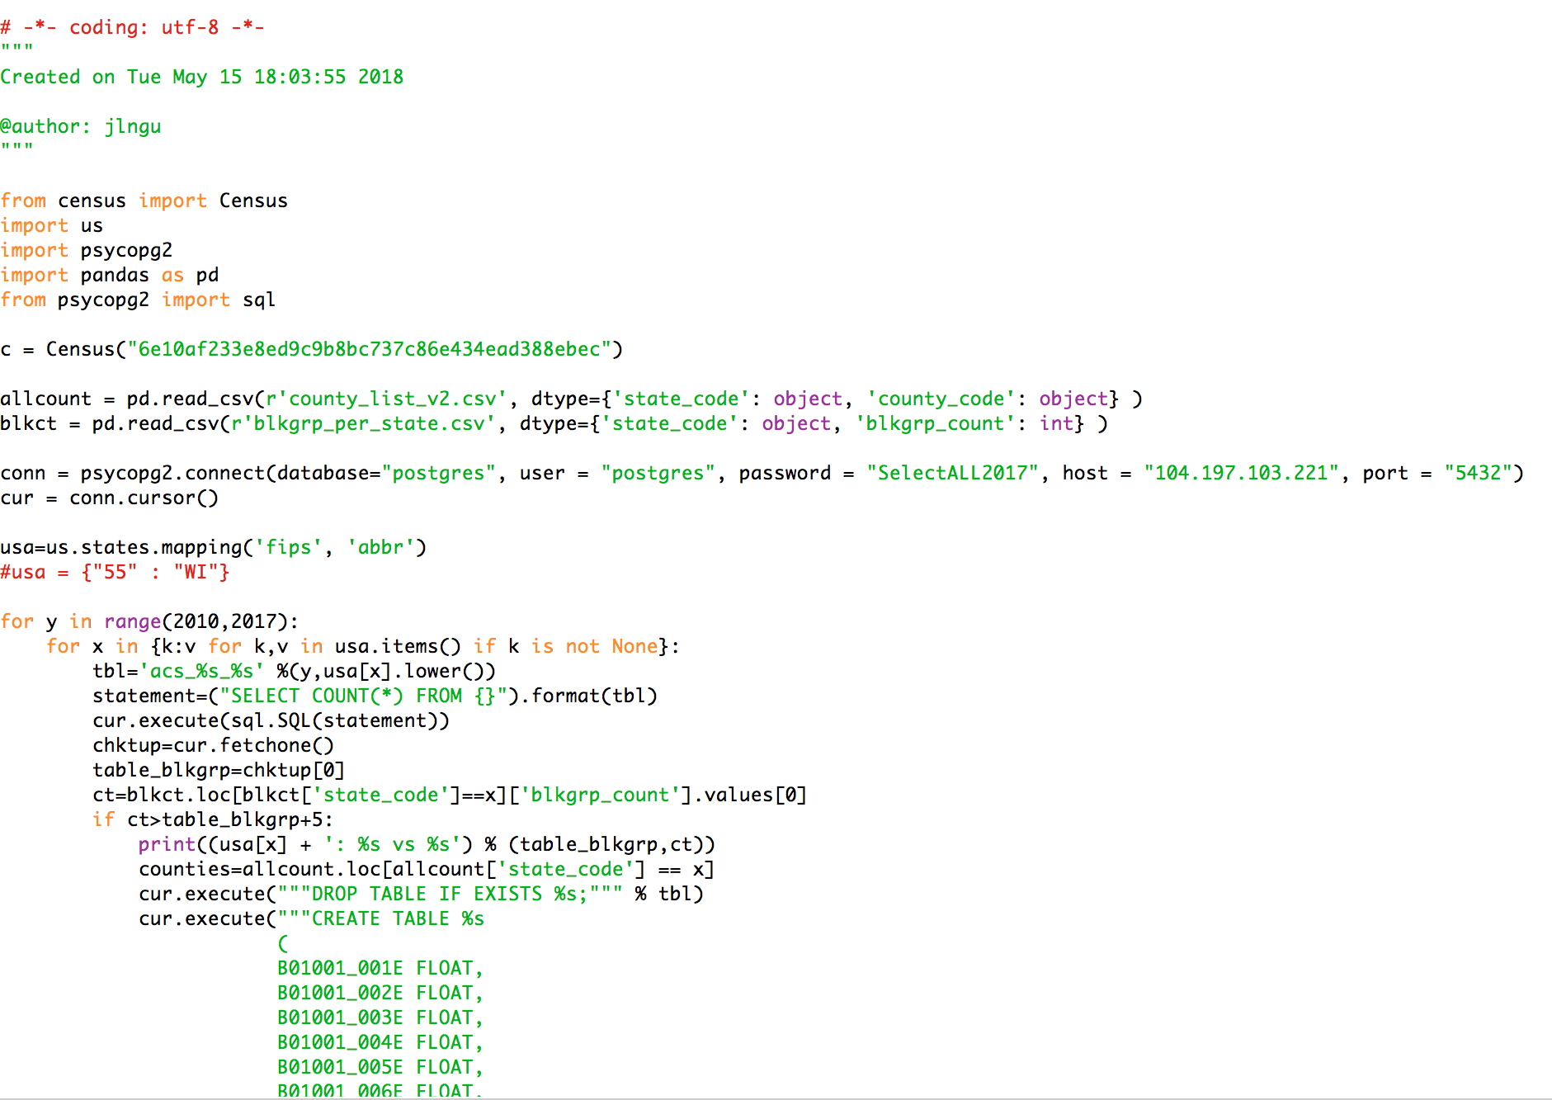
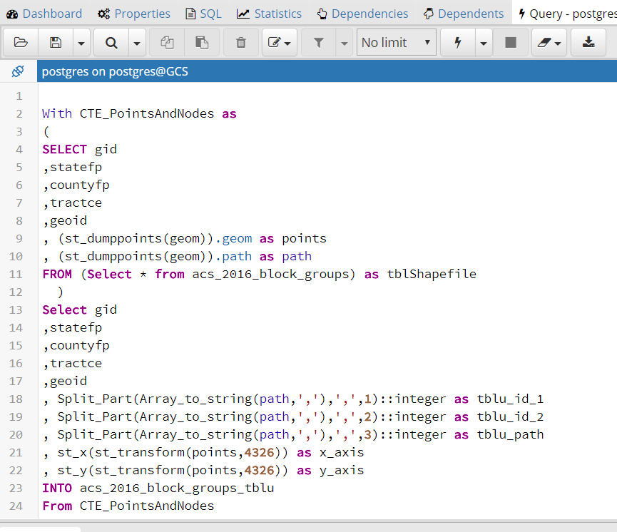
Challenges
Used ACS and Zillow as input data sources. Other data sources were too rich and not standardized to be used in the analysis.
Zillow does not allow using their APIs to extract or manipulate real time data. CSV datasets are pushed to PostgreSQL using R.
Tried using Census API to pull ACS data through Python scripts. Size of the data posed significant challenges for checking data integrity. Additional scripts were developed to ensure it.
Loading BlockGroup shape files from PostgreSQL to Tableau was inefficient. Used SQL scripts to decompose shapes into lines and points and overlay them which improved performance dramatically.
Using Tableau server to pull data from PostgreSQL for visualizations. We have created ad hoc instances in GCP to increase the efficiency and make it faster but it is still taking a lot of time to populate.
Data Integrity Check-Python
Decomposing shapefiles into point and line sets with PostGIS

Slide 29
Conclusions & Recommendations
Gentrification areas identified in the result - Chicago(Bronzeville, Little Italy) & LA(Boyle Heights, Arlington Heights, Koreatown)
Combined influencing factors into Gentrification Index (Gini Index). Among those factors:
Income
Rent
Difference between actual and asked price of a housing unit
City planners can take necessary actions to mitigate these effects based on the indices calculated for all block groups that indicate early signs of gentrification
We recommend...
Taking into account that data for this analysis is likely to be massive and unstandardized due to various sources it comes from
Further experimentation with different factors and calculations of Gini Index is recommended to see potential relationships between those factors
Getting additional data sources and standardizing the data is necessary to run better models

